Slide 1
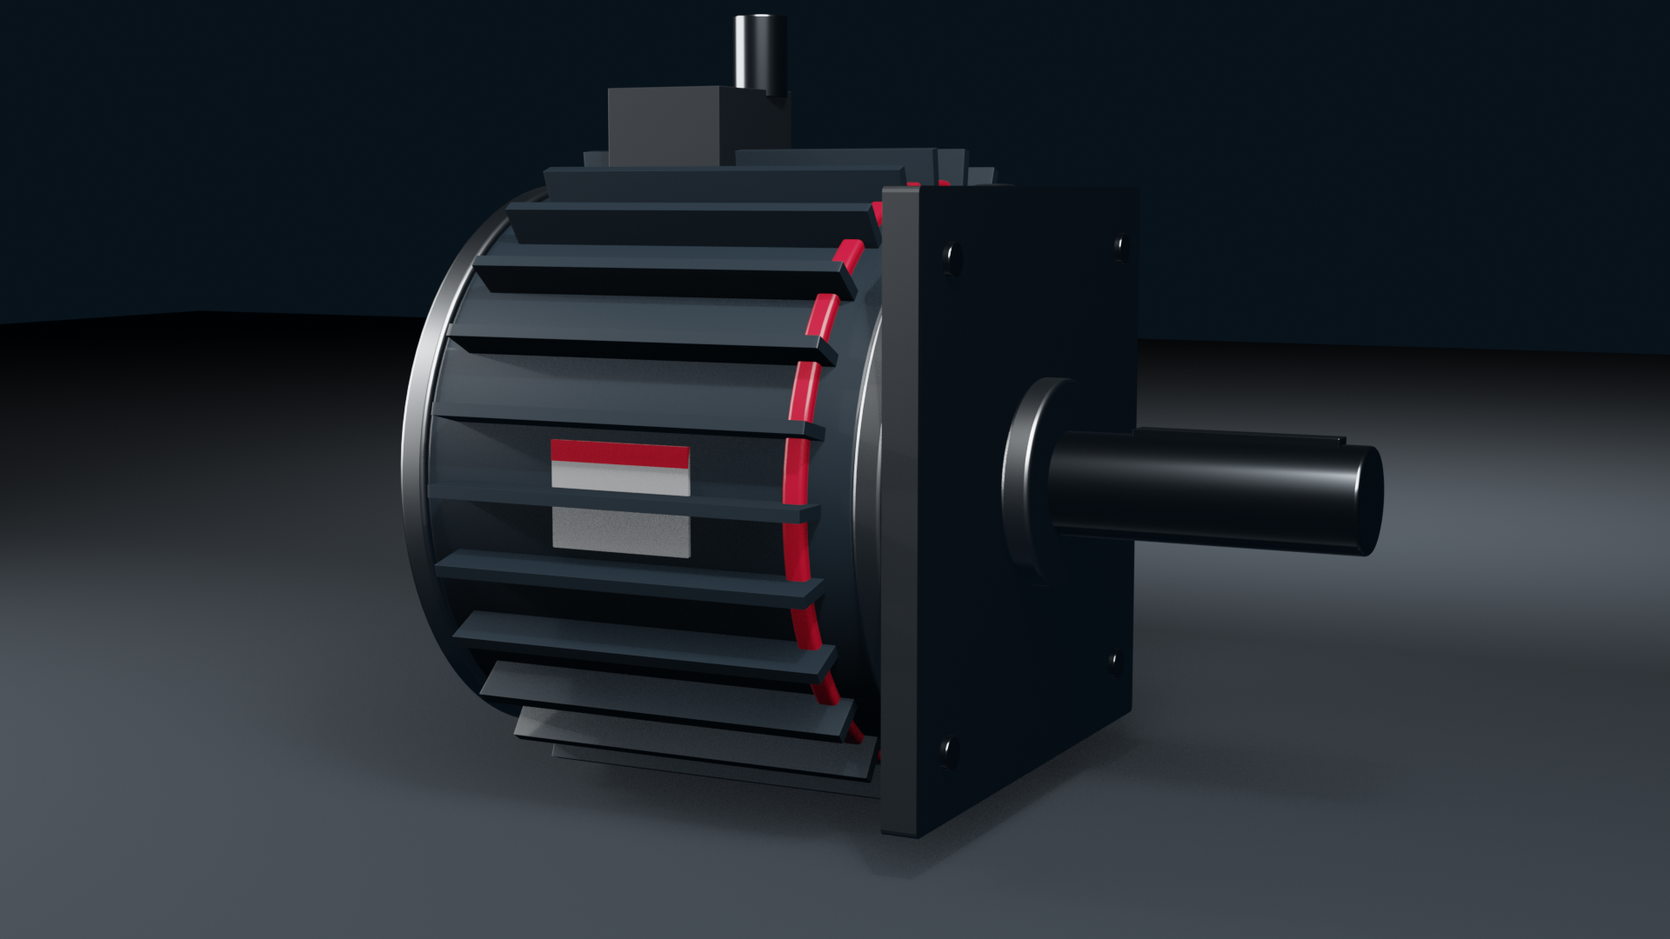

RPG Global Facilities Map 2026
RPGMotor Works

Slide 2

Map slide
World map in Aluminium with a red pin for each facility. Stuttgart has a larger pin as global headquarters.
Copy the slide into your deck; don't move the pins.
© 2026 RPGMotor Works GmbH | Internal

Slide 3
Our eight facilities
Stuttgart, Germany: global headquarters and R&D
Munich, Germany: manufacturing, AeroX® and eMotion®
Kitchener, Ontario, Canada: manufacturing and Americas headquarters
Detroit, Michigan, USA: mobility engineering and manufacturing
Greenville, South Carolina, USA: Industrial Drives manufacturing
San Luis Potosí, Mexico: EV traction plant
© 2026 RPGMotor Works GmbH | Internal

