Slide 1
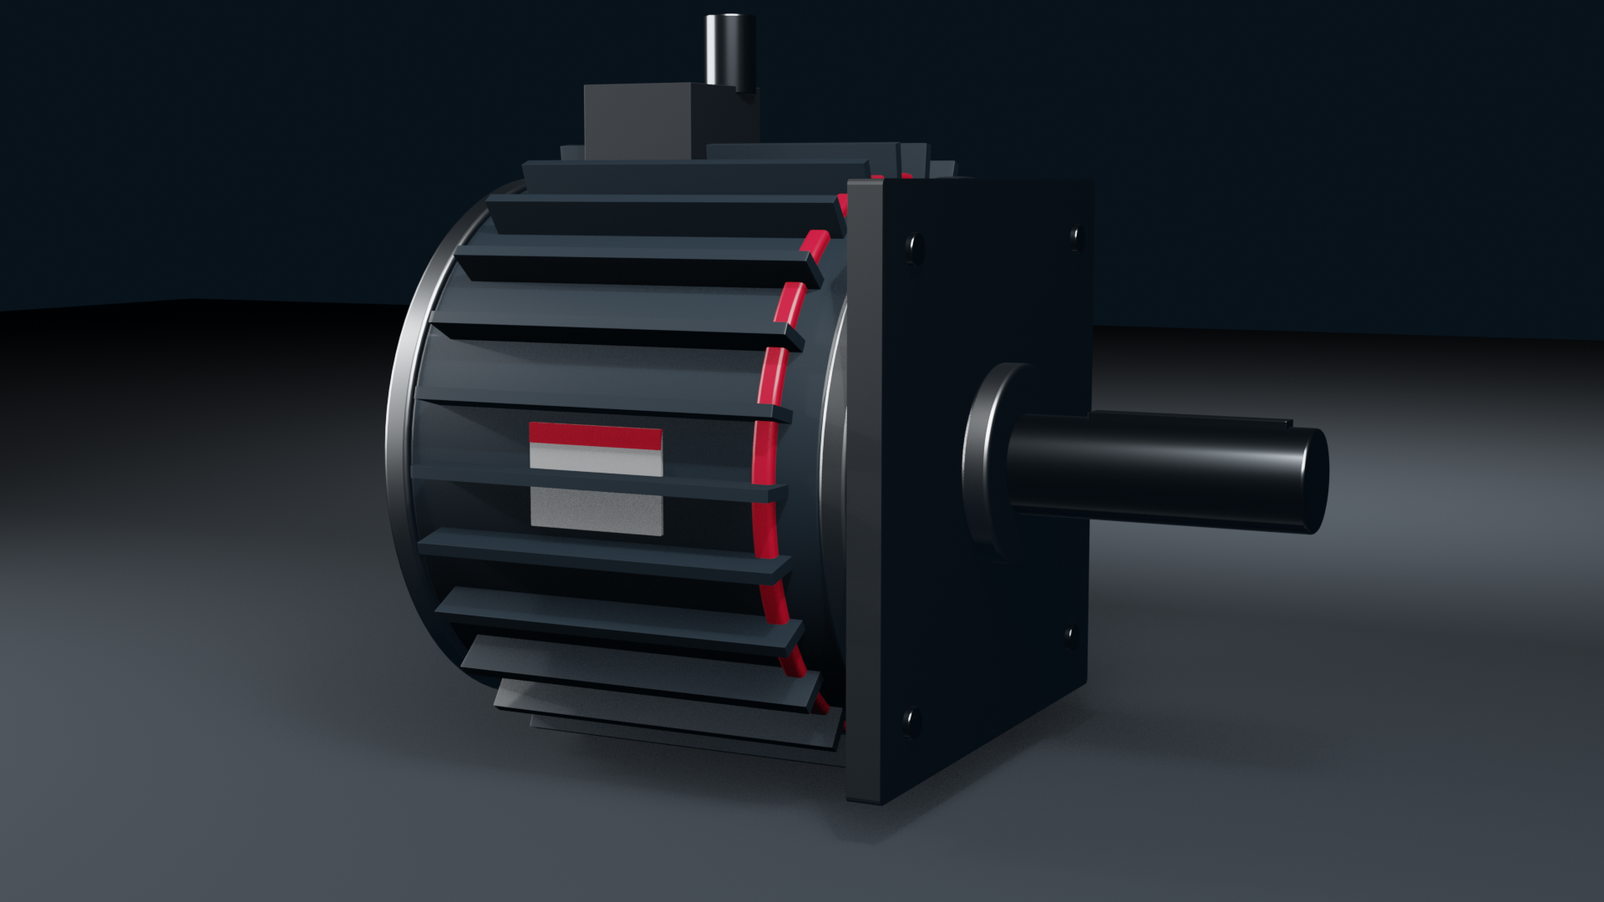

Presentation Template 2027
RPGMotor Works

Slide 2

Title slide
Horizontal lockup top left, application photo on the right. Title in Barlow ExtraBold, two lines at most.
Presenter name, job title and date go in the subtitle box.
© 2026 RPGMotor Works GmbH | Internal

Slide 3
Title slide, Stator Navy
For keynotes and the RPGMotor Engineering Summit. The white lockup sits on a full Stator Navy background.
© 2026 RPGMotor Works GmbH | Internal

Slide 4
Section divider
Section number in RPG Red, section title in white on Stator Navy. Keep titles under six words.
© 2026 RPGMotor Works GmbH | Internal

Slide 5
Agenda
Up to six items. Numbering and spacing are set by the layout, so don't add your own.
Use the agenda again as a progress marker before each section, with the current item in RPG Red.
© 2026 RPGMotor Works GmbH | Internal

Slide 6
Title and content
Six bullets at most, two levels deep.
If Barlow isn't installed, the template falls back to Arial; keep body text at 18 pt or larger.
© 2026 RPGMotor Works GmbH | Internal

Slide 7
Two columns
Compare two options, or pair a short text column with an image or chart.
Keep both columns the same length; move overflow to a new slide rather than shrinking the type.
© 2026 RPGMotor Works GmbH | Internal

Slide 8
Three columns
For three benefits or three steps. Each column takes one icon from the icon library.
© 2026 RPGMotor Works GmbH | Internal

Slide 9
Product family overview
One family per slide: render, family name with ® or ™, descriptor in caps and three key specs.
Renders come from the 3D model library on the Video & Photography page.
© 2026 RPGMotor Works GmbH | Internal

Slide 10
Product comparison table
Steel Gray header row with Aluminium shading. SI units first, imperial in parentheses.
© 2026 RPGMotor Works GmbH | Internal

Slide 11
Application photo
Full-bleed photo with a Stator Navy caption bar. Use only photos from the image library.
© 2026 RPGMotor Works GmbH | Internal

Slide 12
Case study
Challenge, solution, result in three blocks.
Get the customer's written approval before showing it outside RPGMotor Works.
© 2026 RPGMotor Works GmbH | Internal

Slide 13
Data chart
Data Blue and Signal Yellow for series, Steel Gray for axes and gridlines.
Add a source line under every chart.
© 2026 RPGMotor Works GmbH | Internal

Slide 14
Key figures
Up to four large numbers in RPG Red, each with a one-line label.
© 2026 RPGMotor Works GmbH | Internal

Slide 15
Timeline
Milestones run left to right, eight at most.
Dates in Barlow Condensed SemiBold caps, one short line of text per milestone.
© 2026 RPGMotor Works GmbH | Internal

Slide 16
Quote
Customer or employee quote with name, job title and organization. A signed release is required.
© 2026 RPGMotor Works GmbH | Internal

Slide 17
Team and contacts
Portraits cropped to circles, name and role below each one.
Use the official portrait from the HR directory; no selfies or cropped group photos.
© 2026 RPGMotor Works GmbH | Internal

Slide 18
Global footprint
Map with our eight facilities. Copy it from the RPG Global Facilities Map 2026 deck rather than drawing your own.
© 2026 RPGMotor Works GmbH | Internal

Slide 19
Software screen
Device frame for DriveSense® screenshots. Blur customer names and asset IDs.
© 2026 RPGMotor Works GmbH | Internal

Slide 20
Image and text
Half-page image with a headline and up to 60 words of text.
© 2026 RPGMotor Works GmbH | Internal

Slide 21
Closing
Tagline lockup with contact details. Never retype the tagline in plain text.
The legal line and copyright notice stay on this slide.
© 2026 RPGMotor Works GmbH | Internal

