Slide 1
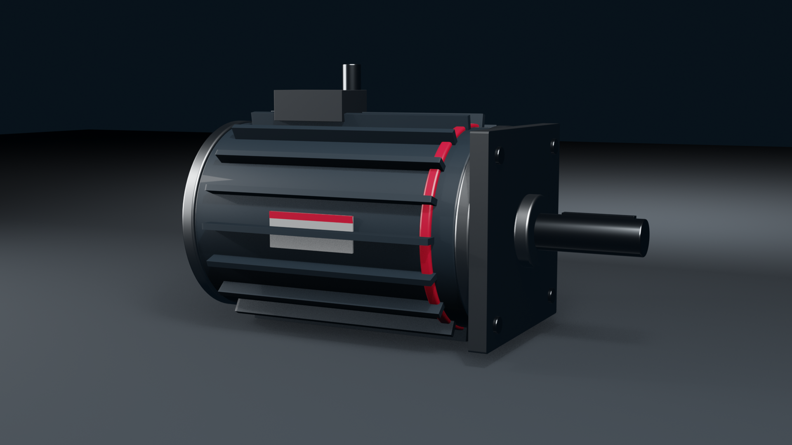

Trade show standards
Sales team lineup, 2026

Slide 2

Purpose
This standard covers how RPGMotor Works plans, staffs and runs trade shows, from a 3 x 3 m stand at a regional fair to the main booth at Hannover Messe. It applies to employees, channel partners exhibiting under our brand and the agencies that build for us.
Owner: Derek Tran, Events Manager. Questions go to marketing@rpgmotor-works.com.
© 2026 RPGMotor Works GmbH | Internal

Slide 3
Show calendar
The global calendar is set every September for the following year. Core shows are Hannover Messe, automatica, SPS, IMTS, Automate, EV Tech Expo Europe, MD&M West, Drives & Controls and IMTEX.
Divisions can propose additional shows by 1 October
Shows added later need a business case and a budget owner
© 2026 RPGMotor Works GmbH | Internal

Slide 4
Planning timeline
Working back from opening day
6 months: space booked, booth size and layout agreed
4 months: products and demos chosen, hardware requested from the plants
3 months: graphics briefed; staffing plan and hotel blocks confirmed
8 weeks: final graphics approved by Brand, print files to Kessler Druck
6 weeks: hardware crated and shipped
© 2026 RPGMotor Works GmbH | Internal

Slide 5
Booth system and graphics
Booths are built from the modular RPG booth system: Stator Navy walls, Aluminium frame, white ceiling ring with the horizontal logo. Back walls carry one message per panel and one large product image.
Logo high on the back wall and on the ceiling ring, visible from 30 m
RPG Red under 15 percent of any wall
Panel copy no longer than 12 words
© 2026 RPGMotor Works GmbH | Internal

Slide 6
Product displays
Show fewer products, better. Each plinth holds one product family, lit from above, with a short label giving the family name, the key figure and a QR code to the product page.
Sectioned motors are the best display we have; ask the plants early
Never show a product that isn't released without written approval from the division head
© 2026 RPGMotor Works GmbH | Internal

Slide 7
Live demos
Demos show a motor doing a real job: a RoboTorq arm picking parts, a ServoXcel axis running a tight motion profile, DriveSense flagging a bearing fault before it fails.
Every demo has a trained owner on each shift
Guarding and emergency stops as on a customer line
Screens show live data, not looping videos
© 2026 RPGMotor Works GmbH | Internal

Slide 8
Booth staffing
Plan one staff member per 9 m² of open booth space, plus one engineer per live demo. Shifts run no longer than four hours on the floor without a break.
Sales reps, application engineers and product managers on every shift
A named show lead is on site from build to teardown
Staff for the last hour as well as the first
© 2026 RPGMotor Works GmbH | Internal

Slide 9
Staff briefing
Two weeks before the show, the show lead runs a one-hour briefing for everyone working the booth. It covers the key messages, the demos, lead capture, the meeting room booking system and who to call when something goes wrong.
Attendance is required. Staff who miss it watch the recording before they arrive.
© 2026 RPGMotor Works GmbH | Internal

Slide 10
Dress code
Booth staff wear the RPG event shirt in Stator Navy with the Rotor on the left chest, dark trousers or skirt and clean, closed shoes suitable for standing all day.
Two shirts per person per show day, ordered through Bluefield Merch
No other company or partner logos on clothing
Jackets in Stator Navy or charcoal on cold days
© 2026 RPGMotor Works GmbH | Internal

Slide 11
Badges and name tags
Wear the show badge and the RPG name tag at all times on the floor. Name tags show first name, last name and job title in Barlow SemiBold, with the Rotor on the left.
Order name tags with your shirt order
Never lend your show badge to anyone
© 2026 RPGMotor Works GmbH | Internal

Slide 12
Greeting visitors
Stand at the edge of the booth facing the aisle. Open with a question about the visitor's work, listen and then match a product or demo to what they told you.
Two minutes is enough to qualify a visitor; book a meeting if more is needed
Hand over to a colleague by name, never walk away mid-conversation
© 2026 RPGMotor Works GmbH | Internal

Slide 13
Lead capture with BoothScan
All leads are captured in BoothScan on the booth tablets or your phone. Scan the visitor's badge, then add their application, timeline, the products they asked about and the next step.
A lead without notes is not a lead
No paper forms, business card bowls or spreadsheets
Leads sync to the CRM each night and go to the owning sales rep the next morning
© 2026 RPGMotor Works GmbH | Internal

Slide 14
Customer meetings
Larger booths include a closed meeting room for pre-booked customer meetings. Book it through the show calendar. Walk-in use is allowed only when the room is free and the show lead agrees.
Meetings run no longer than 45 minutes
Clear the table and wipe the screen after every meeting
© 2026 RPGMotor Works GmbH | Internal

Slide 15
Literature
We bring little print. Each family has one A4 overview sheet; everything else is a QR code to the website. Keep a small stock of the current product catalog for distributors.
Print quantities agreed with the show lead
Leftover literature is recycled after the show, not shipped back
© 2026 RPGMotor Works GmbH | Internal

Slide 16
Giveaways
Giveaways come from the approved range at Bluefield Merch and carry the Rotor or the horizontal logo, never a product name.
Useful, durable items only: torque bit sets, cable ties, notebooks
No sweets, plush toys or single-use plastics
Hand them out after a conversation, not from a bowl
© 2026 RPGMotor Works GmbH | Internal

Slide 17
Social media at shows
Sofia Romano's team posts from the official accounts. Booth staff are welcome to post from their own accounts as long as they follow the social media guidelines.
Photograph the booth before the aisle fills up
No photos of customers without their permission
Never post prototypes, pricing or anything behind the storage room door
© 2026 RPGMotor Works GmbH | Internal

Slide 18
Competitors and press
Be polite to competitors who visit the booth, and keep the conversation general. Don't discuss pricing, roadmaps or customer names with them.
Send journalists straight to Tomas Krause, Head of Communications, or the press contact on the show schedule. Booth staff don't give interviews.
© 2026 RPGMotor Works GmbH | Internal

Slide 19
Health and safety
The show lead knows the hall's emergency exits, the nearest first aid station and the organizer's safety contact. Every live demo has an emergency stop that any staff member can reach in two steps.
Report any injury or near miss to the show lead within the hour
© 2026 RPGMotor Works GmbH | Internal

Slide 20
Teardown and return shipping
No one starts teardown before the hall officially closes. Pack in reverse order using the crate list, photograph each crate before it is sealed and confirm the return shipment with Events before you leave the hall.
Customer-owned or borrowed hardware goes back directly to its owner
Damaged graphics are logged for reprinting, not repacked
© 2026 RPGMotor Works GmbH | Internal

Slide 21
Follow-up within 48 hours
Every qualified lead hears from RPGMotor Works within 48 hours of the show closing. The owning sales rep sends a personal email that refers to the conversation in BoothScan and proposes a clear next step.
Generic thank-you mailers do not count as follow-up
Sales Directors review open leads one week after each show
© 2026 RPGMotor Works GmbH | Internal

Slide 22
Show report
Within two weeks, the show lead files a short report: leads captured and qualified, meetings held, cost per qualified lead, what worked and what to change next year. Events keeps the reports with the booth drawings for the next planning round.
© 2026 RPGMotor Works GmbH | Internal

