Slide 1
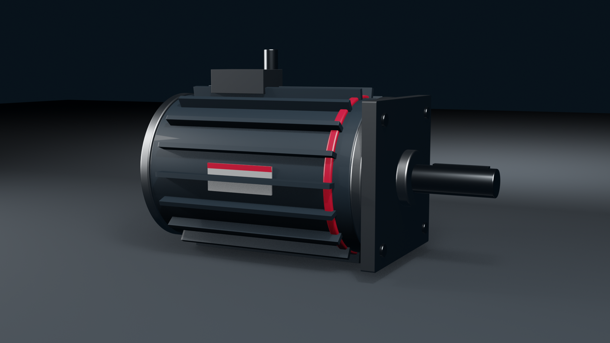

Trade show standards
Sales team lineup, 2026

Slide 2

RPGMotor Engineering Summit 2026
Stuttgart headquarters, Building A Forum. Tuesday 16 June to Wednesday 17 June 2026.
Two days for customer engineers, channel partners and our own application teams to work through real drive problems with the people who design our motors. Sessions are in English. Registration is by invitation through your RPGMotor Works sales contact.
The hardware gallery in the foyer stays open both days, with sectioned motors from every product family and engineers from each division on hand to answer questions.
© 2026 RPGMotor Works GmbH | Internal

Slide 3
Day 1 morning: where motion is heading
08:30 Registration and coffee in the Forum foyer
09:15 Welcome from the Managing Director
09:45 Keynote: designing motors for twenty years of service
10:45 Break and hardware gallery
11:15 Panel: electrification in heavy equipment, with CargoMax and eMotion engineers
12:30 Lunch in the staff restaurant
© 2026 RPGMotor Works GmbH | Internal

Slide 4
Day 1 afternoon: technical tracks
Choose one track per session
13:45 Track A: servo tuning for high-dynamic axes with ServoXcel
13:45 Track B: thermal design for sealed BLDC motors
15:15 Track A: RoboTorq joint integration, from CAD to commissioning
14:45 Break and coffee
15:15 Track B: DriveSense condition data and what it tells you
© 2026 RPGMotor Works GmbH | Internal

Slide 5
Day 2: hands-on labs
09:00 Lab 1: motor sizing workshop, bring your own duty cycle
09:00 Lab 2: encoder and feedback troubleshooting
10:30 Break
11:00 Lab 3: AeroX qualification process (restricted, cleared attendees only)
11:00 Lab 4: WindTurn pitch and yaw drive maintenance
12:30 Lunch and one-to-one engineering clinics
© 2026 RPGMotor Works GmbH | Internal

Slide 6
Practical information
The Forum is a five-minute walk from the visitor car park. Safety shoes are provided for the factory tour and the labs; please bring your own if you prefer. Photography is not allowed in the test halls.
Tell us about dietary requirements when you register. Every session room has a hearing loop, and all slides are shared with attendees after the summit, except material from the restricted AeroX lab.
Questions about travel, hotels or accessibility: Derek Tran, Events Manager, marketing@rpgmotor-works.com, or the Germany switchboard on +49 711 555 0100.
© 2026 RPGMotor Works GmbH | Internal

