Slide 1
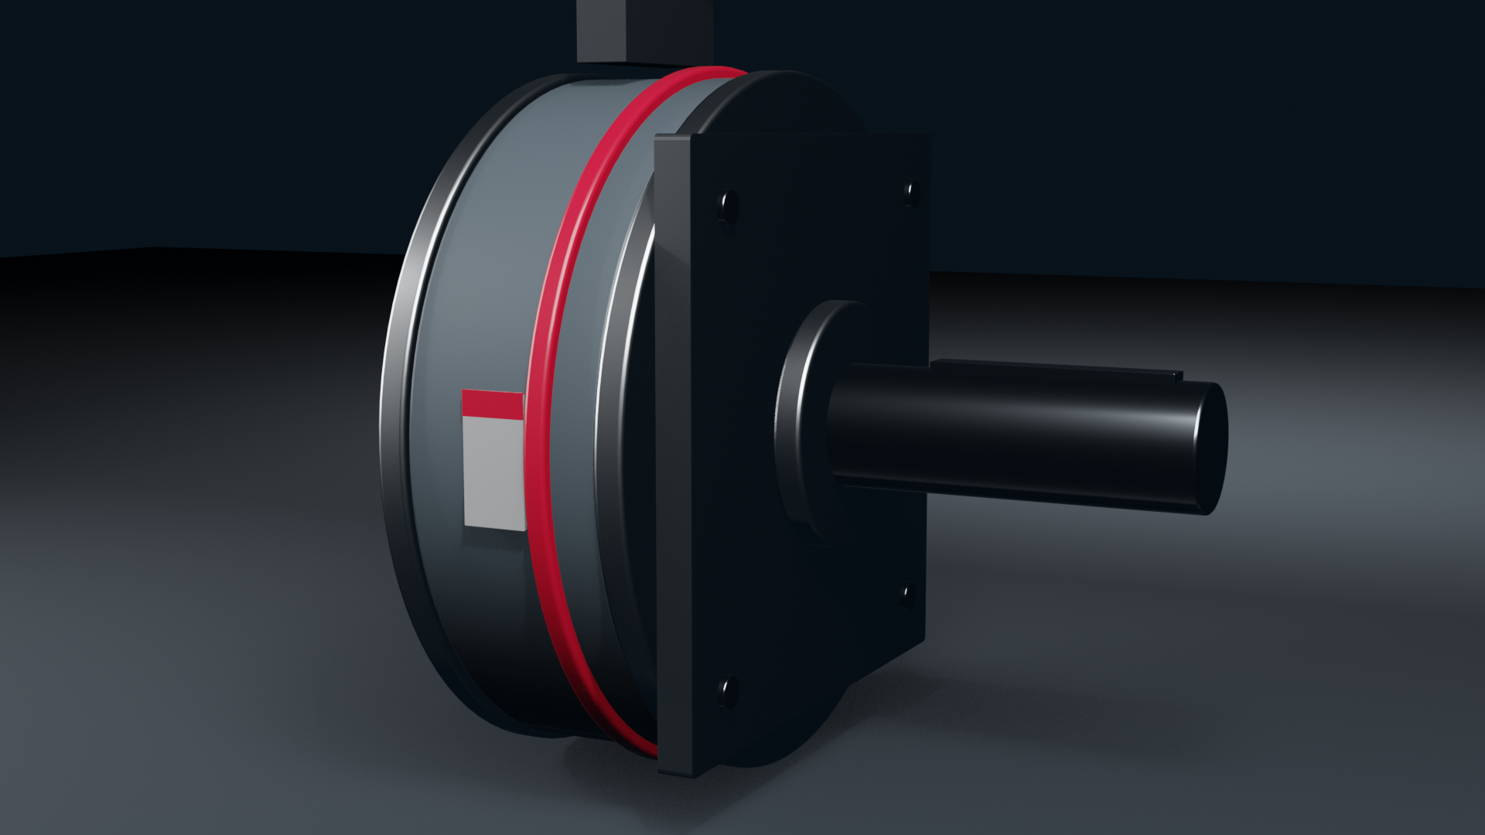

Project documentation
Sample deck: RoboTorq palletizing cell

Slide 2
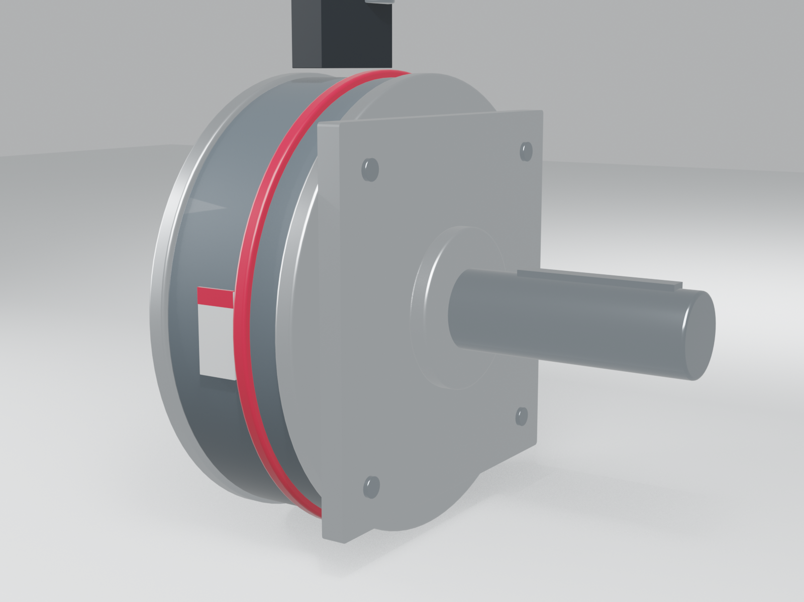

The application
Food and beverage palletizing, four-axis robot
Six RoboTorq joint motors per robot
DriveSense monitoring on every axis
© 2026 RPGMotor Works GmbH | Internal

Slide 3
Results
Cycle time down 11 percent after retrofit
No unplanned stops in the first 6 months
Customer approved this sheet for external use
© 2026 RPGMotor Works GmbH | Internal

